Slide 1


HRMS Training
1. Attendance Management

Slide 2
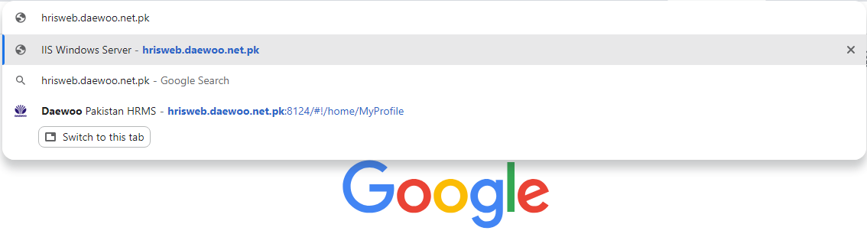
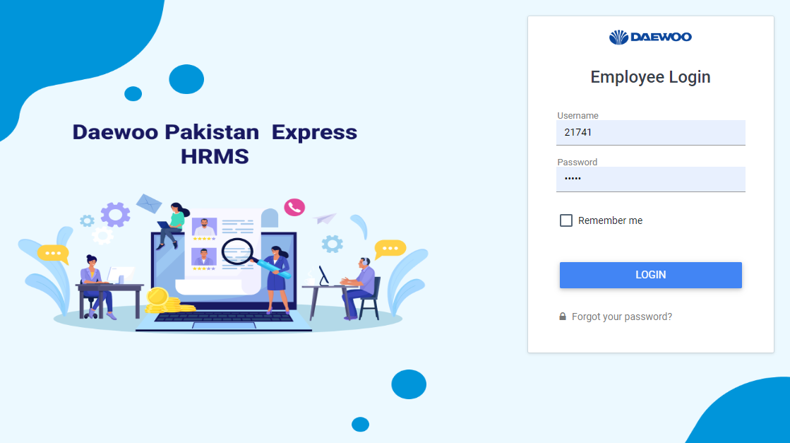
STEP 1
Open Google Chrome. Enter the URL
hris.web.daewoo.net.pk
STEP 2
Enter your Login Details
(Employee username &Password) to login to your profile

Slide 3
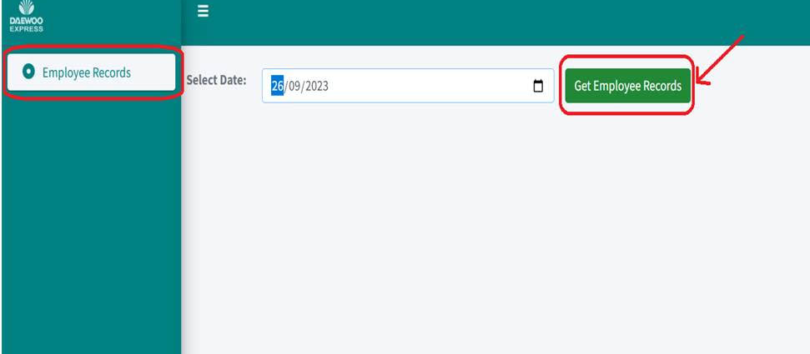
Homepage will appear
STEP 3
On left side of home page. Click on Employee Records
STEP 4
STEP 5
Mention exact Date.
Click on Get Employee Records.

Slide 4
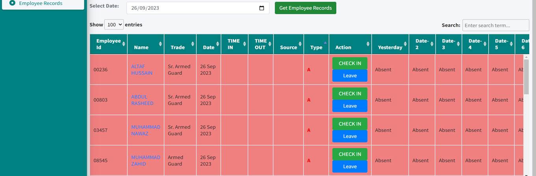
This page will appear
Those who are Absent will be highlighted with Red Color and sorted as well
You’ll get Employee record associated with their Employee ID

Slide 5
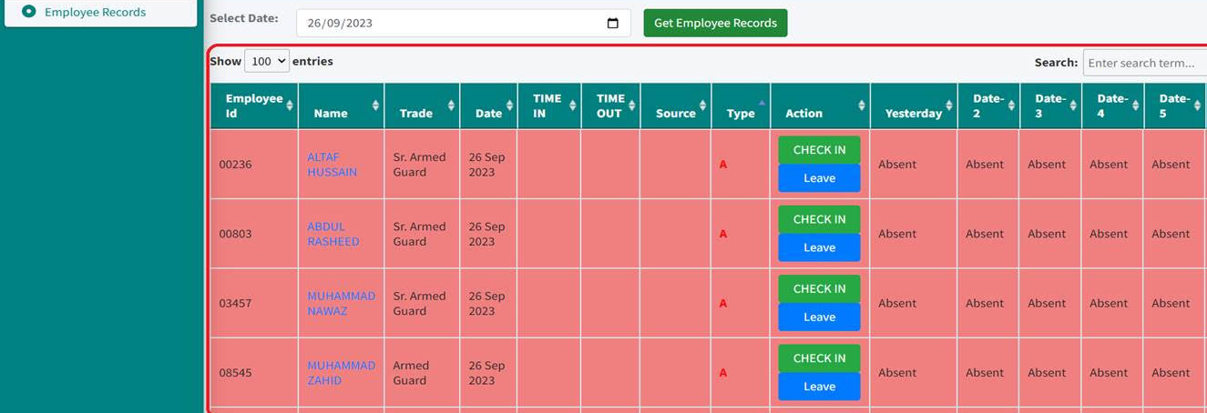
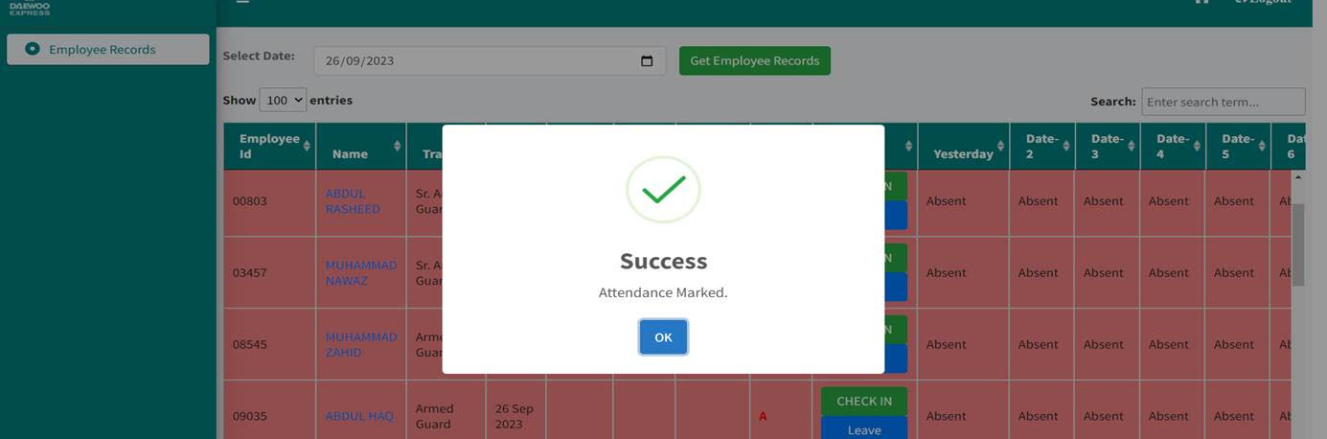
STEP 6
To mark attendance, Click on Check In against that Employee Id.
Use this Action Button is to mark Attend and Leave.
This dialogue box will appear, This means your attendance has been marked

Slide 6
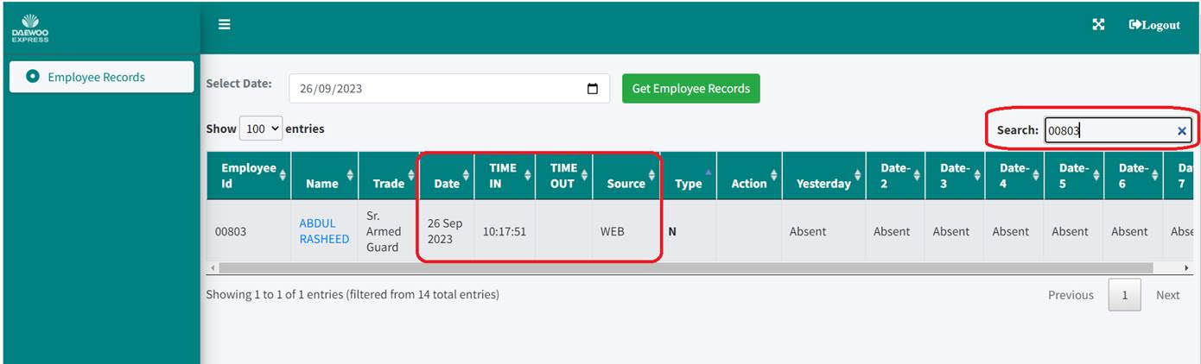
These Columns will indicates the time you enter or leave the office.
STEP 7
To review attendance, enter employee ID and search.
Source Column will indicates from which source attendance was marked. (Web - Mobile).

Slide 7
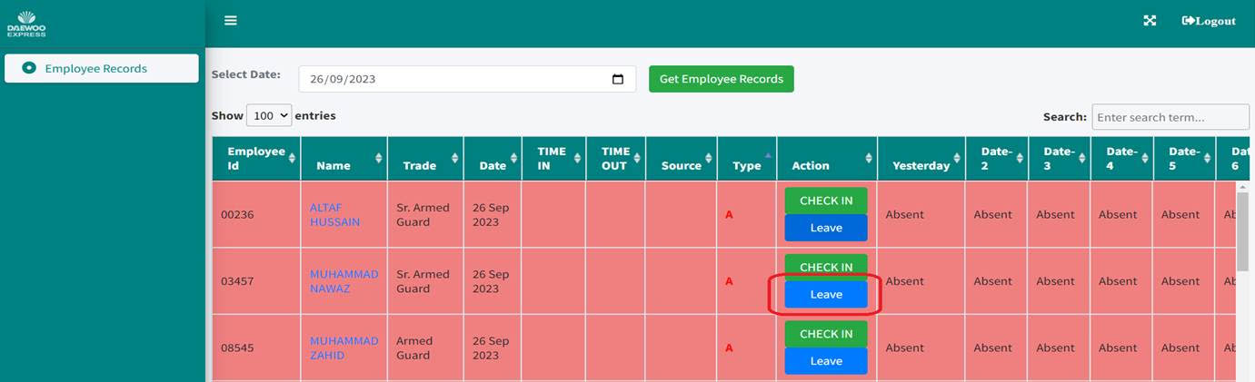
STEP 8
To apply for leave, click leave button of that particular employee

Slide 8
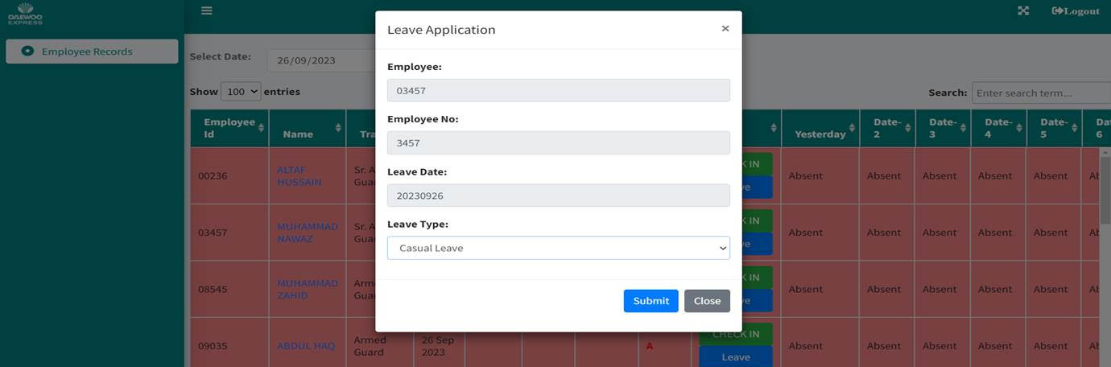
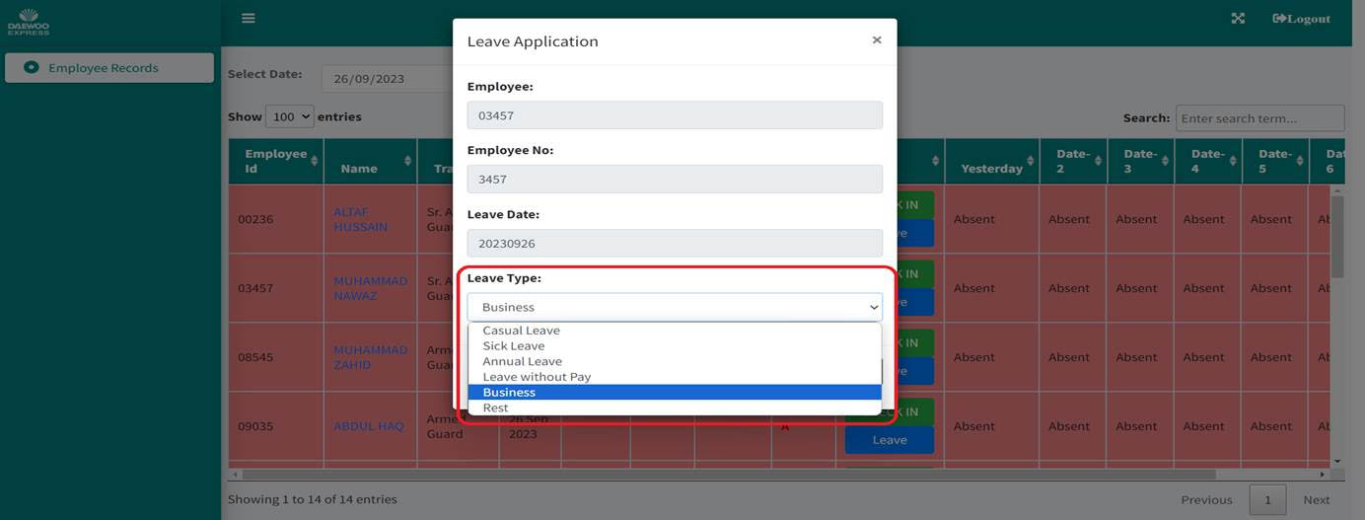
On clicking Leave Button, This Dialogue Box will appear
STEP 9
Enter all credentials properly and click submit
STEP 10
When you click leave type, various options will pop up, choose the most relevant one
STEP 11
After entering all information, click submit

Slide 9
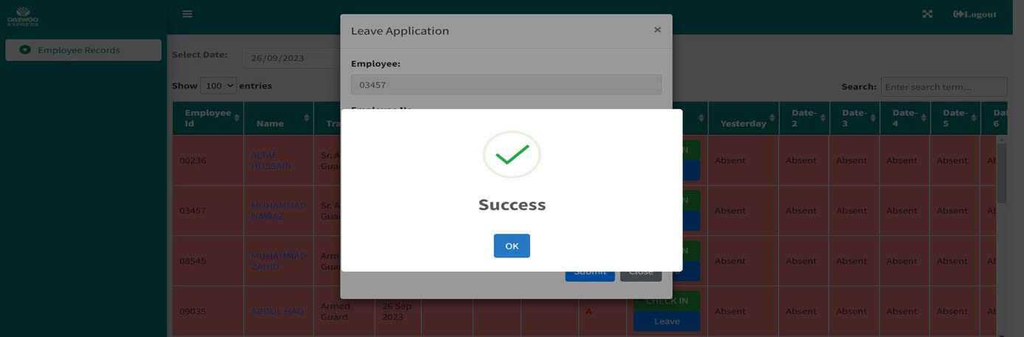
STEP 12
This dialogue box will appear, This means your leave has been successfully submitted

